Slide 1
JavaScript Objects

Slide 2
Node Package Manager
Objects can be created using an
object literal
object constructor
function constructor

Slide 3
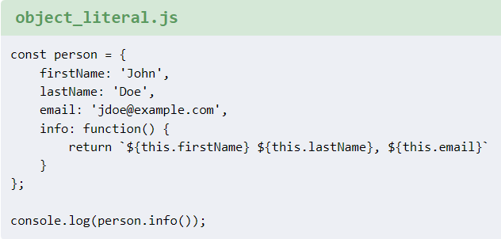
Object literal
In object literal notation, object attributes are separated by comma inside curly brackets {}.
The attribute names & values are separated with colon.

Slide 4
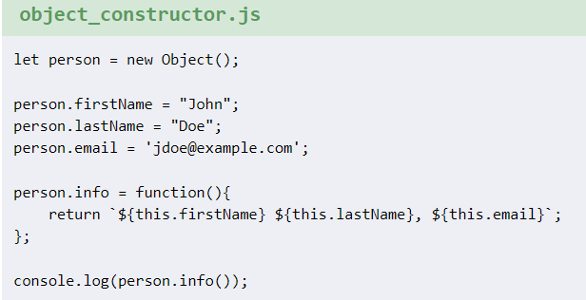
Object constructor
Objects can be created with new Object constructor. Attributes are then dynamically added using dot operator.

Slide 5
Function constructor
A function constructor is created with a function keyword.
It takes the values as parameters.
The attributes are set using this keyword.
Methods are created with this and function keywords.
New objects are created with new keyword.

Slide 6
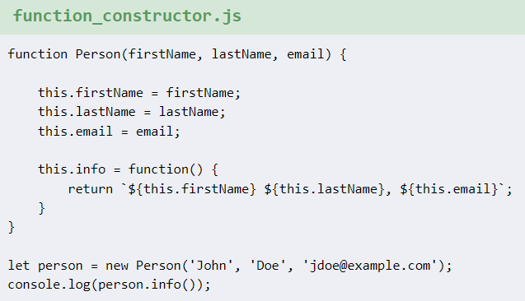
Function constructor
https://zetcode.com/javascript/createobject/

